Slide 1
Artificial Intelligence Survey
CMPT 310, Spring 2020
Slide credits: Dan Klein and Pieter Abbeel

Slide 2
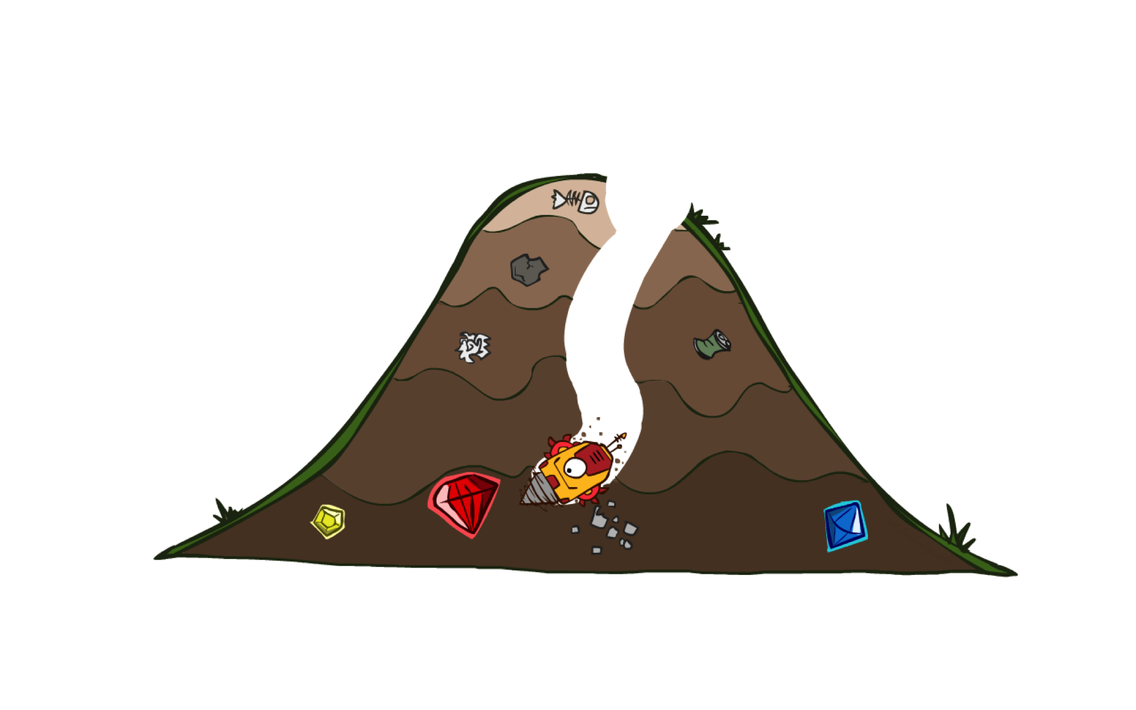
A* Search

Slide 3
Combining UCS and Greedy
Uniform-cost orders by path cost, or backward cost g(n)
Greedy orders by goal proximity, or forward cost h(n)
A* Search orders by the sum: f(n) = g(n) + h(n)
8
g = 0 h=6
S
e
h=1
g = 1 h=5
a
1
1
3
2
g = 2 h=6
g = 9 h=1
S
a
d
G
b
d
g = 4 h=2
e
h=6
1
h=5
h=2
h=0
1
g = 3 h=7
g = 6 h=0
g = 10 h=2
c
b
c
G
d
h=7
h=6
g = 12 h=0
G
Example: Teg Grenager

Slide 4
When should A* terminate?
Should we stop when we enqueue a goal?
No: only stop when we dequeue a goal
h = 2
A
2
2
S
h = 3
h = 0
G
2
B
3
h = 1

Slide 5
Is A* Optimal?
h = 6
1
A
3
S
h = 7
G
h = 0
5
What went wrong?
Actual bad goal cost < estimated good goal cost
We need estimates to be less than actual costs!

Slide 6

Admissible Heuristics

Slide 7

Idea: Admissibility
Inadmissible (pessimistic) heuristics break optimality by trapping good plans on the fringe
Admissible (optimistic) heuristics slow down bad plans but never outweigh true costs

Slide 8
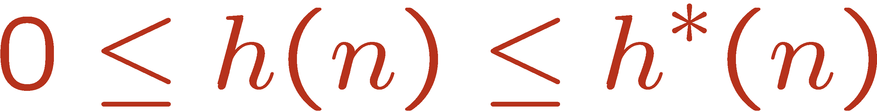


Admissible Heuristics
A heuristic h is admissible (optimistic) if:
where is the true cost to a nearest goal
Examples:
Coming up with admissible heuristics is most of what’s involved in using A* in practice.
4
15

Slide 9

Optimality of A* Tree Search

Slide 10


Optimality of A* Tree Search
Assume:
A is an optimal goal node
B is a suboptimal goal node
h is admissible
Claim:
A will exit the fringe before B
…

Slide 11
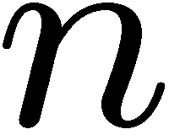

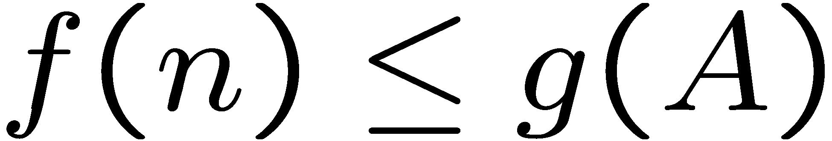
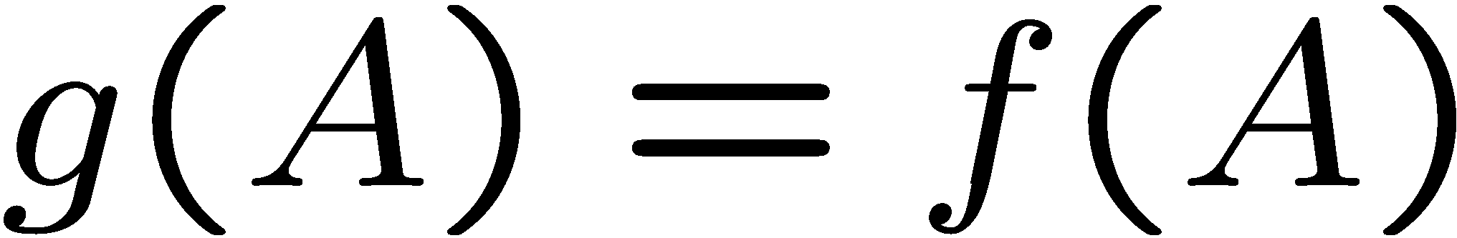
Optimality of A* Tree Search: Blocking
Proof:
Imagine B is on the fringe
Some ancestor n of A is on the fringe, too (maybe A!)
Claim: n will be expanded before B
f(n) is less or equal to f(A)
…
Definition of f-cost
Admissibility of h
h = 0 at a goal

Slide 12


Optimality of A* Tree Search: Blocking
Proof:
Imagine B is on the fringe
Some ancestor n of A is on the fringe, too (maybe A!)
Claim: n will be expanded before B
f(n) is less or equal to f(A)
f(A) is less than f(B)
…
B is suboptimal
h = 0 at a goal

Slide 13
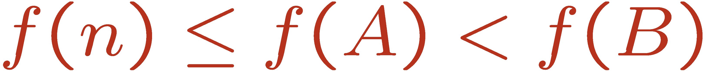
Optimality of A* Tree Search: Blocking
Proof:
Imagine B is on the fringe
Some ancestor n of A is on the fringe, too (maybe A!)
Claim: n will be expanded before B
f(n) is less or equal to f(A)
f(A) is less than f(B)
n expands before B
All ancestors of A expand before B
A expands before B
A* search is optimal
…

Slide 14
Properties of A*
Uniform-Cost
A*
b
b
…
…
Notes:
Uniform cost: expand all around
A*: Go deeper only towards the goal, with some width in search space due to the imperfect heuristics

Slide 15
UCS vs A* Contours
Uniform-cost expands equally in all “directions”
A* expands mainly toward the goal, but does hedge its bets to ensure optimality
Start
Goal
Start
Goal
[Demo: contours UCS / greedy / A* empty (L3D1)]
[Demo: contours A* pacman small maze (L3D5)]

Slide 16

Video of Demo Contours (Empty) -- UCS

Slide 17
Video of Demo Contours (Empty) -- Greedy

Slide 18
Video of Demo Contours (Empty) – A*

Slide 19
Video of Demo Contours (Pacman Small Maze)–A*

Slide 20



Comparison
Greedy
Uniform Cost
A*

Slide 21
A* Applications
Video games
Pathing / routing problems
Resource planning problems
Robot motion planning
Language analysis
Machine translation
Speech recognition
…

Slide 22
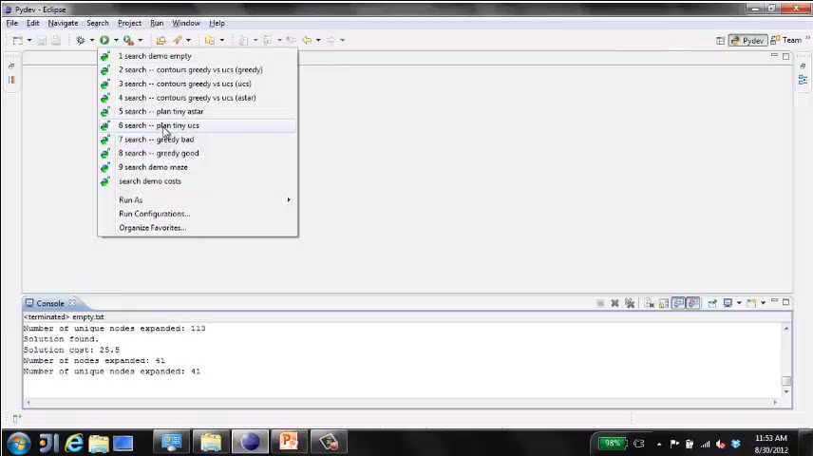
Video of Demo Pacman (Tiny Maze) – UCS / A*

Slide 23
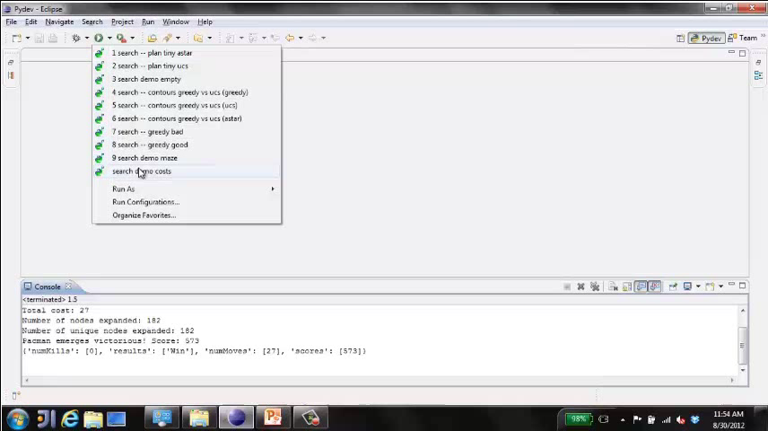
Video of Demo Empty Water Shallow/Deep – Guess Algorithm

Slide 24

Creating Heuristics

Slide 25
Creating Admissible Heuristics
Most of the work in solving hard search problems optimally is in coming up with admissible heuristics
Often, admissible heuristics are solutions to relaxed problems, where new actions are available
Inadmissible heuristics are often useful too
15
366

Slide 26
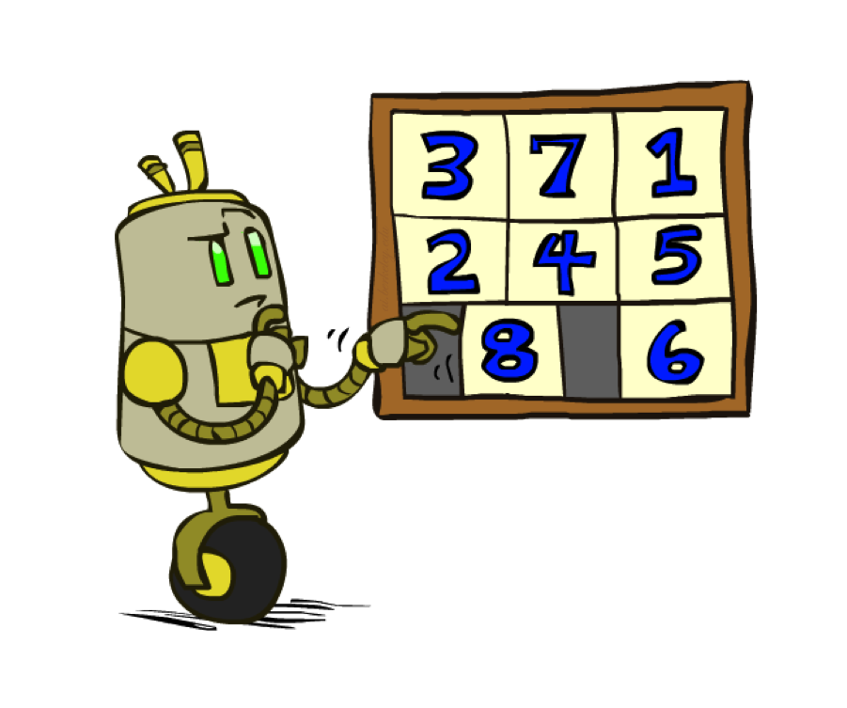
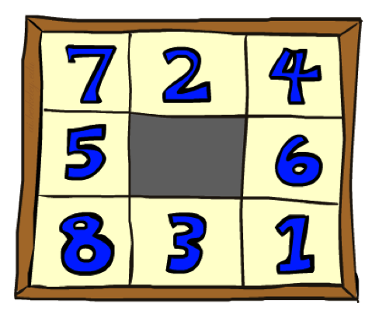
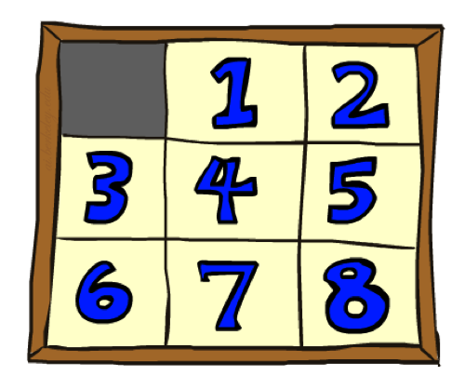
Example: 8 Puzzle
Start State
Actions
Goal State
What are the states?
How many states?
What are the actions?
How many successors from the start state?
What should the costs be?

Slide 27
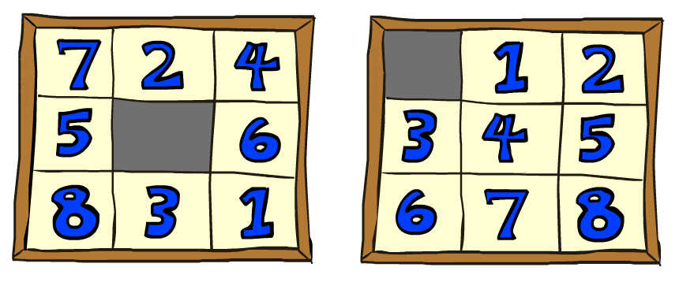
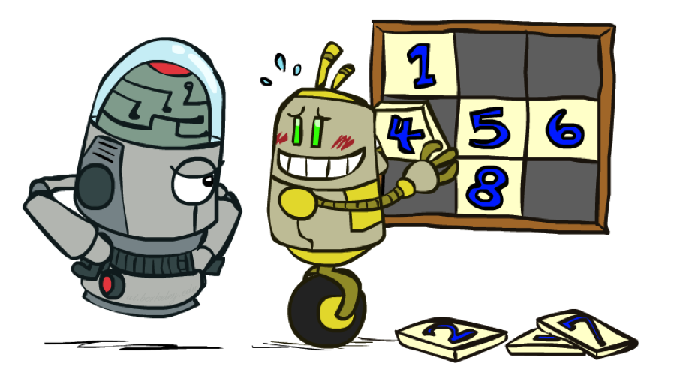
8 Puzzle I
Heuristic: Number of tiles misplaced
Why is it admissible?
h(start) =
This is a relaxed-problem heuristic
8
Start State
Goal State
 | Average nodes expanded when the optimal path has…
 | …4 steps | …8 steps | …12 steps
UCS | 112 | 6,300 | 3.6 x 10⁶
TILES | 13 | 39 | 227
Statistics from Andrew Moore

Slide 28
8 Puzzle II
What if we had an easier 8-puzzle where any tile could slide any direction at any time, ignoring other tiles?
Total Manhattan distance
Why is it admissible?
h(start) =
Start State
Goal State
 | Average nodes expanded when the optimal path has…
 | …4 steps | …8 steps | …12 steps
TILES | 13 | 39 | 227
MANHATTAN | 12 | 25 | 73
3 + 1 + 2 + … = 18

Slide 29
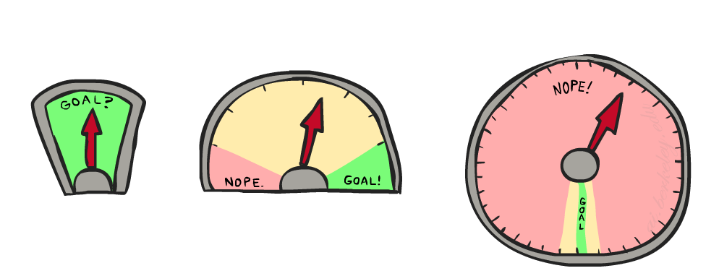
8 Puzzle III
How about using the actual cost as a heuristic?
Would it be admissible?
Would we save on nodes expanded?
What’s wrong with it?
With A*: a trade-off between quality of estimate and work per node
As heuristics get closer to the true cost, you will expand fewer nodes but usually do more work per node to compute the heuristic itself

